Slide 1
WOA7014 ROBOTICS AND INTELLIGENT SYSTEMS
Mini Project 2: Bipedal Walker
Group Team members:
Mohamed Moussad Mohamed Ibrahim (17220121)
Shang Zhiyu (S2000785)

Slide 2
CONTENTS
01.
Problem Definition
02.
Related Work
03.
Environment and Simulation
04.
Proposed Approach
05.
Possible Experiments
06.
Some Initial Results

Slide 3
Problem Definition
The problem of a bipedal robot Bipedal (with 2 legs) robots to be able to walk efficiently is very difficult and most approaches so far have been developed for a robot.
In this project, we will approach the need for a general solution to this problem with a Reinforcement Learning technique. Using only the state of the robot given from sensors (coders at joints) to learn the best policy for a robot to walk without falling.
Using a simple model simulation of a bipedal robot. Agent learning a policy to navigate forward, and Agent learns a body to allow it to bounce forward efficiently.
We reward an agent for developing legs that are smaller in the area and augment its reward signal during training by scaling the rewards by a utility factor.

Slide 4
Related Work
There is a broad literature in evolutionary computation, artificial life, and robotics devoted to studying, and modeling embodied cognition. Subsequent works further investigated morphology evolution, modular robotics, and evolving soft robots using indirect encoding. Literature in passive dynamics studies robot designs that rely on natural swings of motion of body components instead of deploying and controlling motors at each joint. Recent work in robotics investigates simultaneously optimizing body design and control of a legged robot using constraint-based modeling, machine learning-assisted approaches have been used to procedurally generate game environments that can also facilitate policy learning of the game playing agent.

Slide 5
Related Work
Using a simple population-based policy gradient method to learn not only the policy but also a small set of parameters describing the environment, such as its body, offer many benefits. By allowing the agent’s body to adapt to its task within some constraints, it can learn policies that are not only better for its task but also learn them more quickly.
The agent may discover design principles during this process of joint body and policy learning. The agent has learned to break symmetry and learn relatively larger rear limbs to facilitate their navigation policies. While optimizing for material usage for BipedalWalker’s limbs, the agent learns that it can still achieve the desired task even by setting the size of its legs to the minimum allowable size. Design firms can create more realistic environments – for instance, incorporate the strength of materials, safety factors, malfunctioning of components under stressed conditions, and plug existing algorithms into this framework to optimize also for design aspects such as energy usage, easy-of-manufacturing, or durability. The designer may even incorporate aesthetic constraints such as symmetry and aspect ratios that suit her design sense. The limitations of the current approach are that our RL algorithm can learn to optimize only the existing design properties of an agent’s body.

Slide 6
Environment and Simulation
In addition to the weight parameters of our agent's policy network, the agent's environment will be parameterized, which includes the specification of the agent's body structure.
Hence the weights w will be the parameters of the agent's policy network combined with the environment's parameterization vector. During a rollout, an agent initialized with w will be deployed in an environment that is also parameterized with the same parameter vector w.
The learning rate is 0.001 over 10000 episodes.
Layers contain 256 nodes at the outer layer and 512 nodes at the central hidden layer.
Parameter:
Weight
Learning Rate
Total Episodes
Activation Function

Slide 7
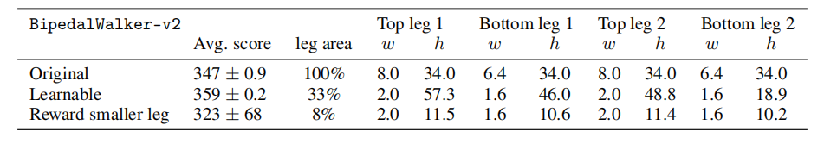
Environment and Simulation
In this environment, our agent generally learns to develop longer, thinner legs, with the exception in the rear leg where it developed a thicker lower limb to serve as useful stability function for navigation.
Its front legs, which are smaller and more manoeuvrable, also act as a sensor for dangerous obstacles ahead that complement its LIDAR sensors. While learning to develop this newer structure, it jointly learns a policy to solve the task in 30% of the time it took the original, static version of the environment.
The average scores over 100 rollouts for the learnable version is 335 ± 37 compared to the baseline score of 313 ± 53. The full results are summarized as follows.

Slide 8
Environment and Simulation
Actions
Num | Name | Min | Max
0 | Hip_1 (Torque / Velocity) | -1 | +1
1 | Knee_1 (Torque / Velocity) | -1 | +1
2 | Hip_2 (Torque / Velocity) | -1 | +1
3 | Knee_2 (Torque / Velocity) | -1 | +1

Slide 9
Environment and Simulation
Rewards
Reward is given for moving forward, total 300+ points up to the far end. If the robot falls, it gets -100.
Applying motor torque costs a small amount of points, more optimal agent will get better score.
State consists of hull angle speed, angular velocity, horizontal speed, vertical speed, position of joints and joints angular speed, legs contact with ground, and 10 lidar rangefinder measurements. There's no coordinates in the state vector.

Slide 10
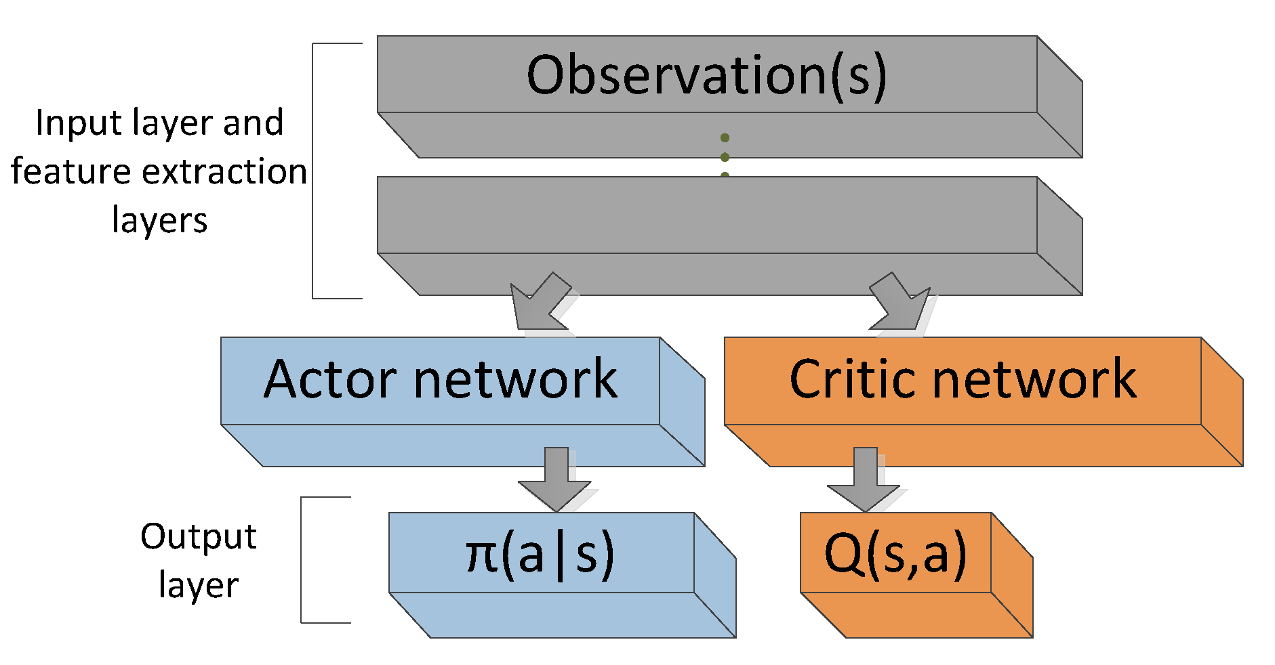
Environment and Simulation
Actor-Critic Network:
Contain 24 observations as state
14 observations for velocity and angles of joints
The action contains 4-dimension vector (2 for each leg)

Slide 11
Environment and Simulation
Training:
The model had been trained at first 6 layers in the actor-network and 5 layers in the critic network.
However, this model did not converge at a good policy and taking reward at zero value. In addition to that, the agent cannot move from its location and fall each episode.
When removing 1 hidden layer from each network and used 64 nodes for the outer layer and 128 nodes for the inner layers.
The complexity will reduce computation and the robot can stay at more stable states and its performance will improve.

Slide 12
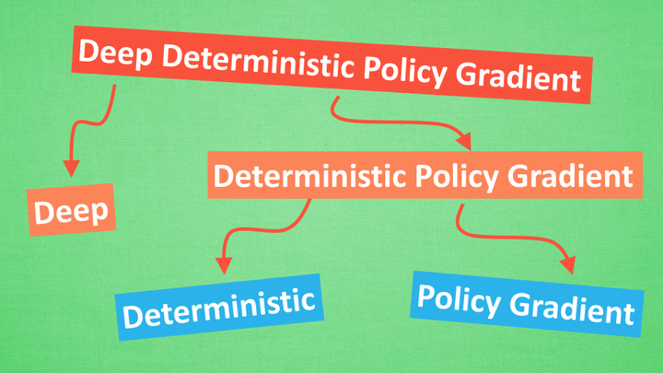
Proposed Approach
Proposed Approach
Deep Deterministic Policy Gradient (DDPG) is an algorithm which concurrently learns a Q-function and a policy. It uses off-policy data and the Bellman equation to learn the Q-function, and uses the Q-function to learn the policy.
Deep Deterministic Policy Gradient (DDPG)
Deep Deterministic Policy Gradient (DDPG)

Slide 13
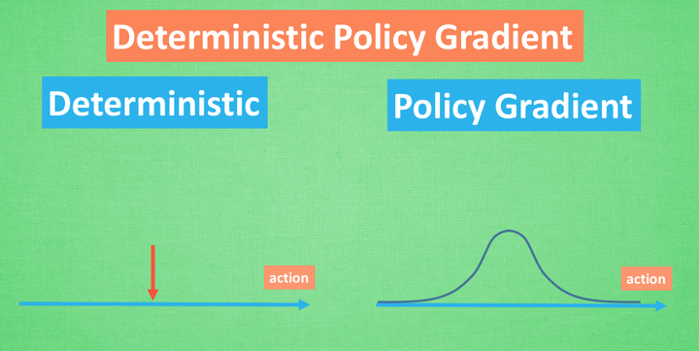
Proposed Approach
Deep Deterministic Policy Gradient (DDPG)
DDPG is an off-policy algorithm.
DDPG can only be used for environments with continuous action spaces.
DDPG can be thought of as being deep Q-learning for continuous action spaces.
The Spinning Up implementation of DDPG does not support parallelization.

Slide 14
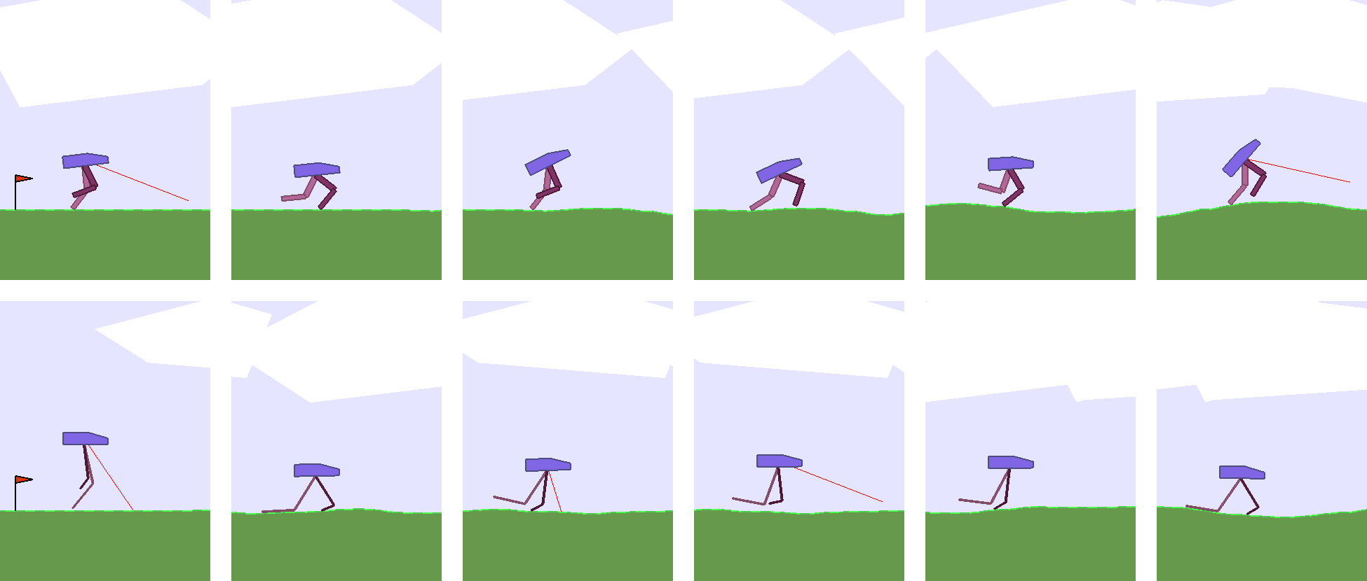
Possible Experiments
The Bipedal Walker series of environments is based on the Box2D physics engine. Guided by LIDAR sensors, the agent is required to navigate across an environment of randomly generated terrain within a time limit, without falling over. The agent's payload – its head, is supported by 2 legs. The top and bottom parts of each leg is controlled by two motor joints.
Agent learning a policy to navigate forward in BipedalWalker-v2 environment

Slide 15
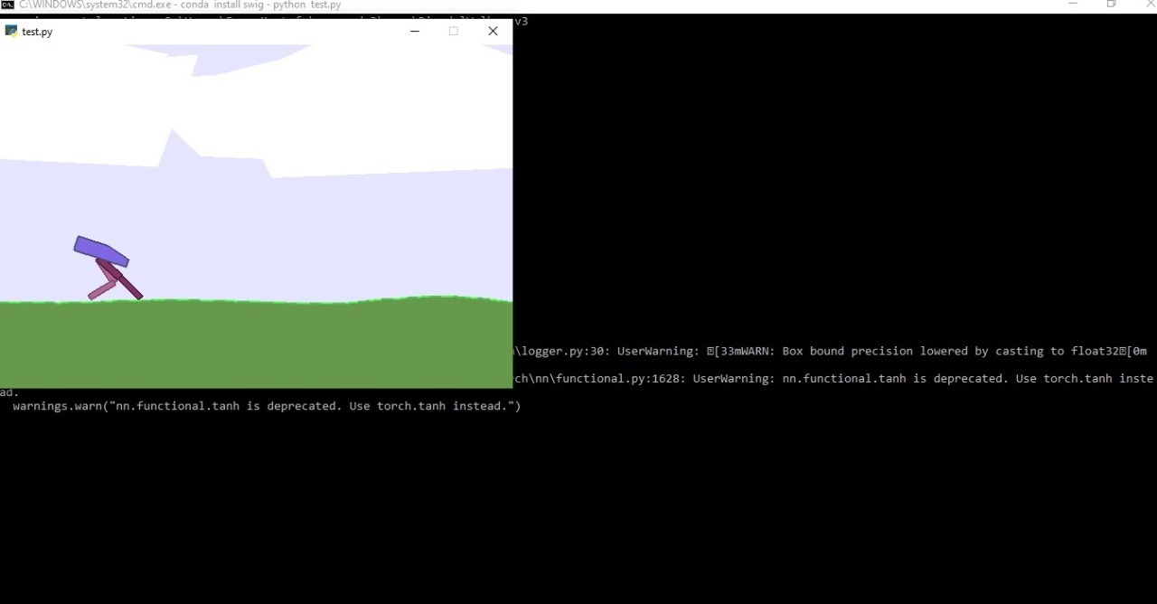
Some Initial Results

Slide 16
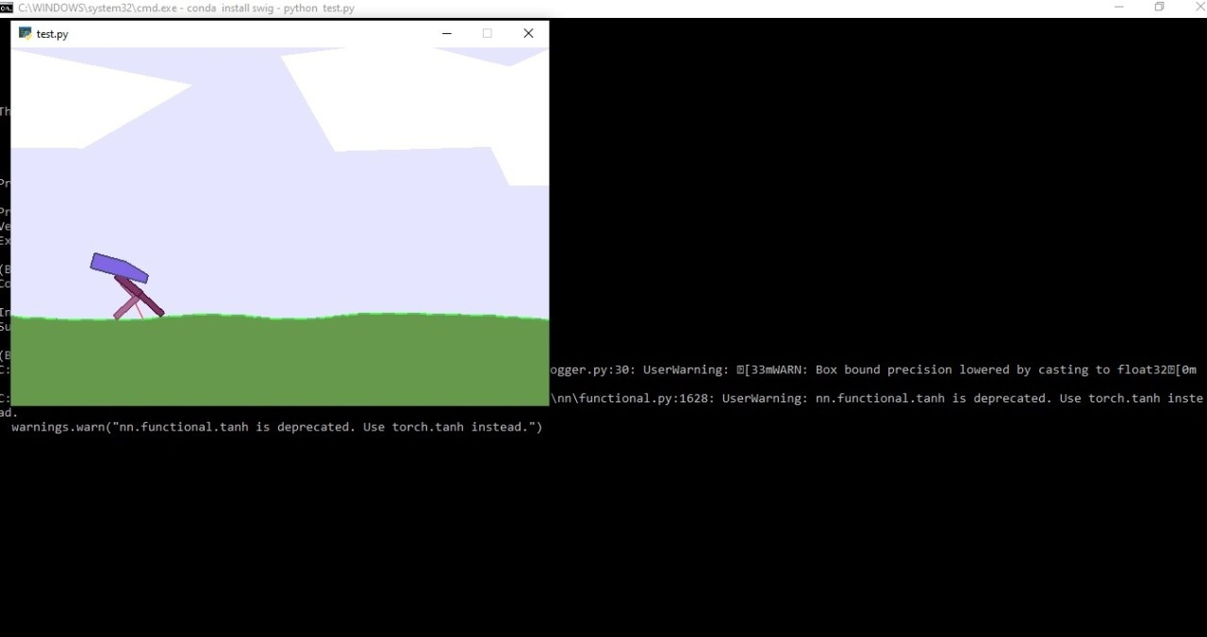

Some Initial Results

